Slide 1


How to find a Full Stack Developer?
And how to be the most employable full stack developer

Slide 2





Situation
Company requires new Full Stack Developer
Required within 2 weeks!!!!!!
Where can you find such a capable great ape?

Slide 3

Complication
Full Stack Developers are in short supply
The #1 Full Stack Developer Doesn’t have a portfolio
Time to get to work…

Slide 4



Implication
Without a Full Stack Developer, the job won’t get done…
There’s an ever-approaching deadline…
We NEED help!!!!!!!!!

Slide 5

Position
A portfolio for the world’s #1 developer needs to be built!
The employer needs to find the right information about the developer
Schedule a date to have your socks blown off!!!!

Slide 6
Design - Sitemap
Home
Experience
Code
Contact
blog
Resume
email
phone
Blog sites
linkedin
github

Slide 7
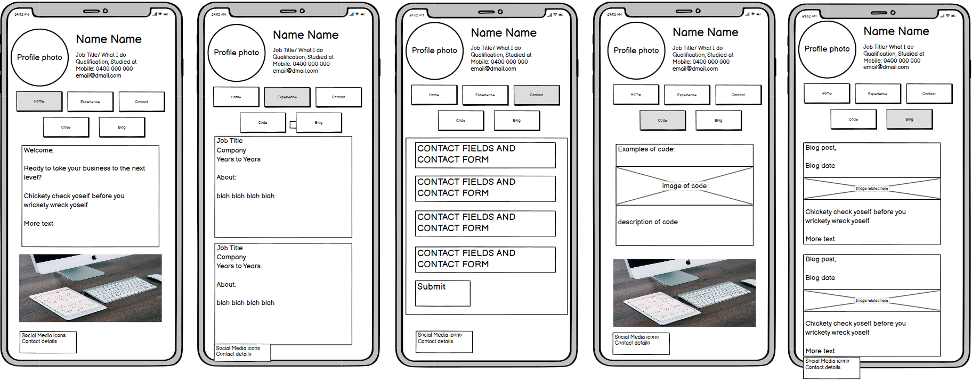
Design – Mobile First
Structure & Navigation

Slide 8
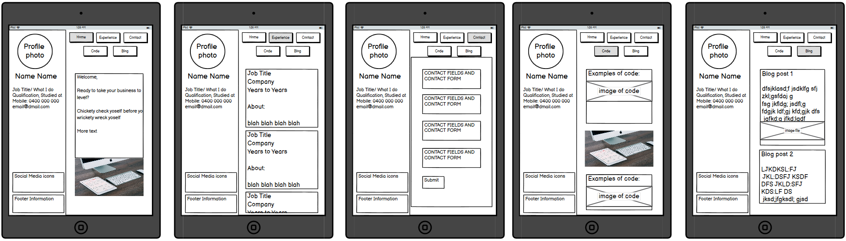
Design – Tablet Layout
Design (aesthetics) &
Decision Making Process

Slide 9
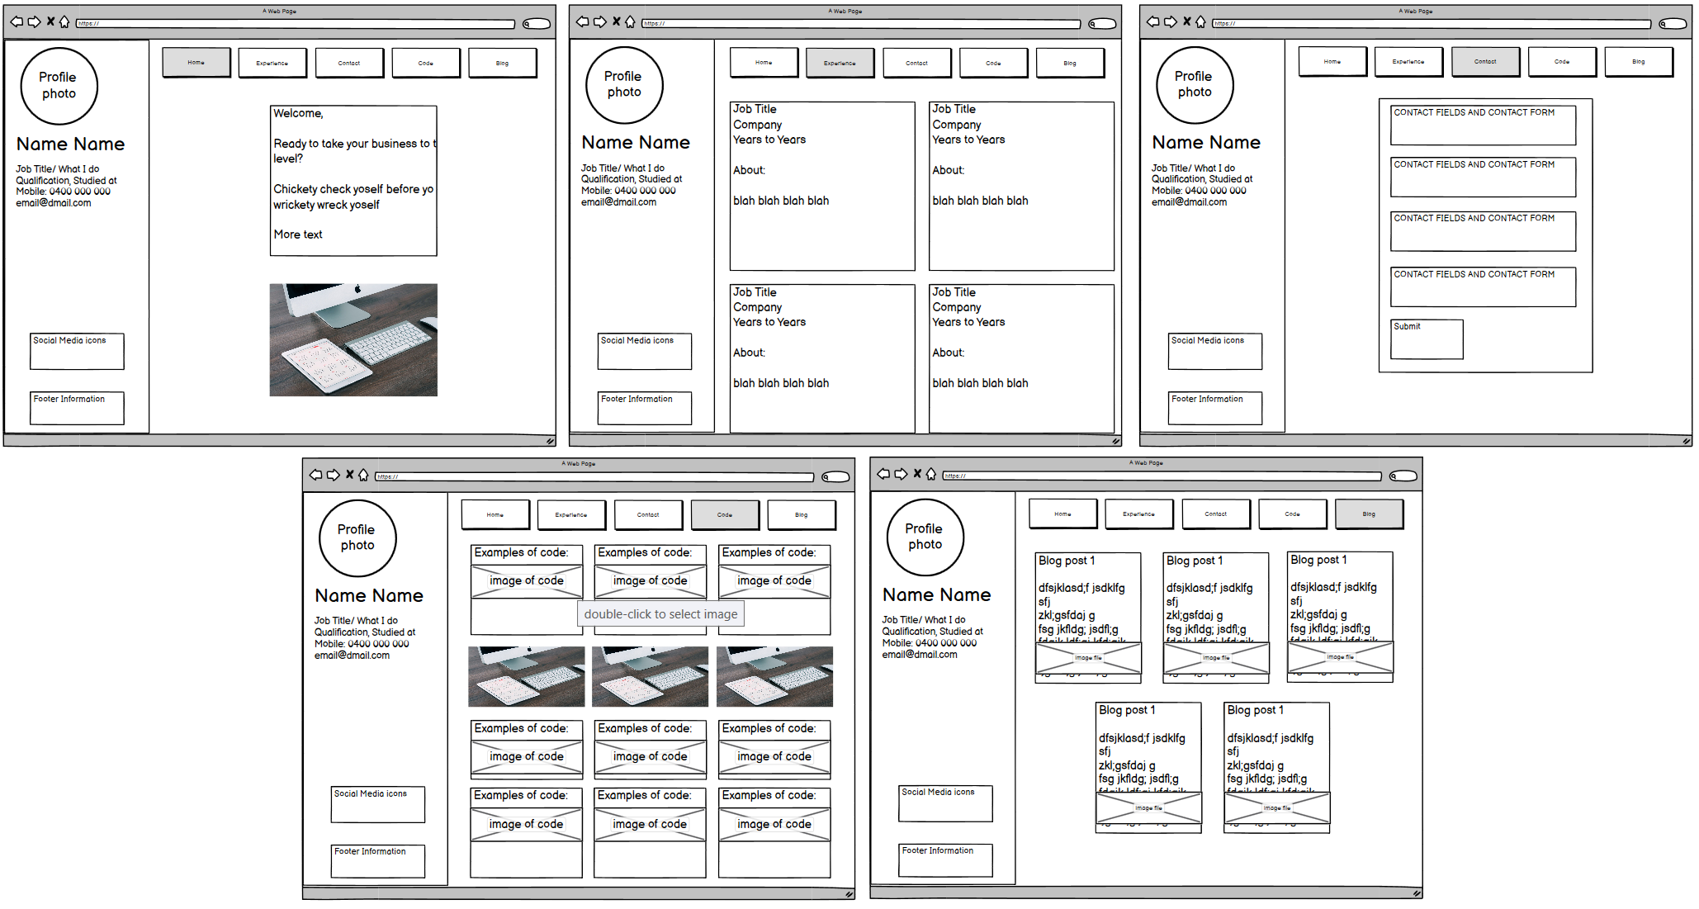
Design – Desktop Layout
How Components &
Styling engages audience

Slide 10
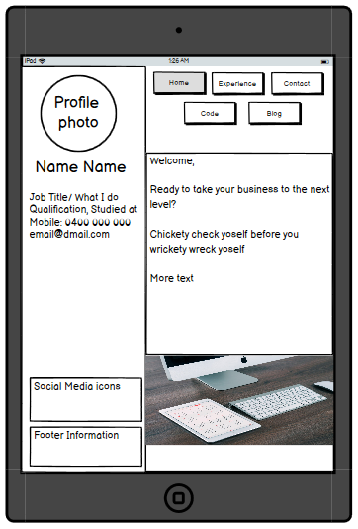
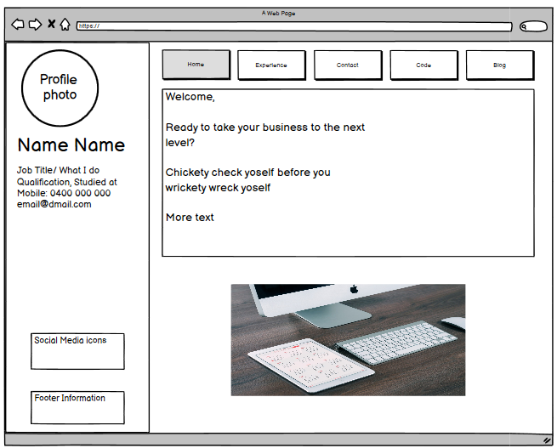
Design – Components Used - How it engages audience
Divs, H2, P, Nav
mob-social-media
social-media
nav
headerinfo
body-content
Profpic
Block
To-top
LAYOUT

Slide 11
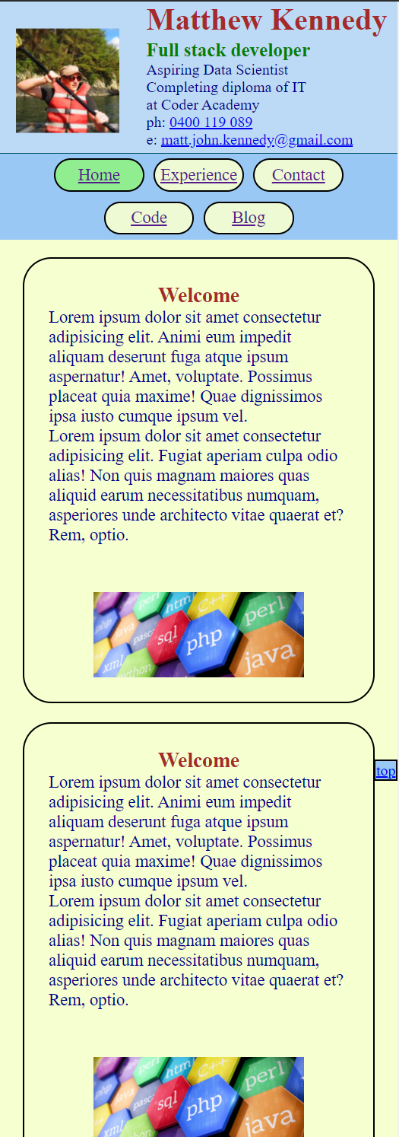
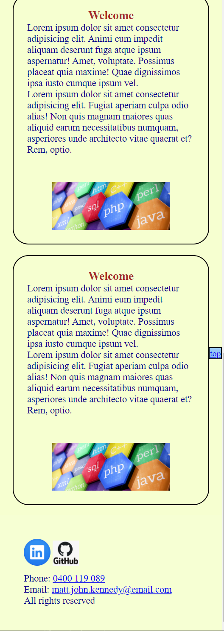
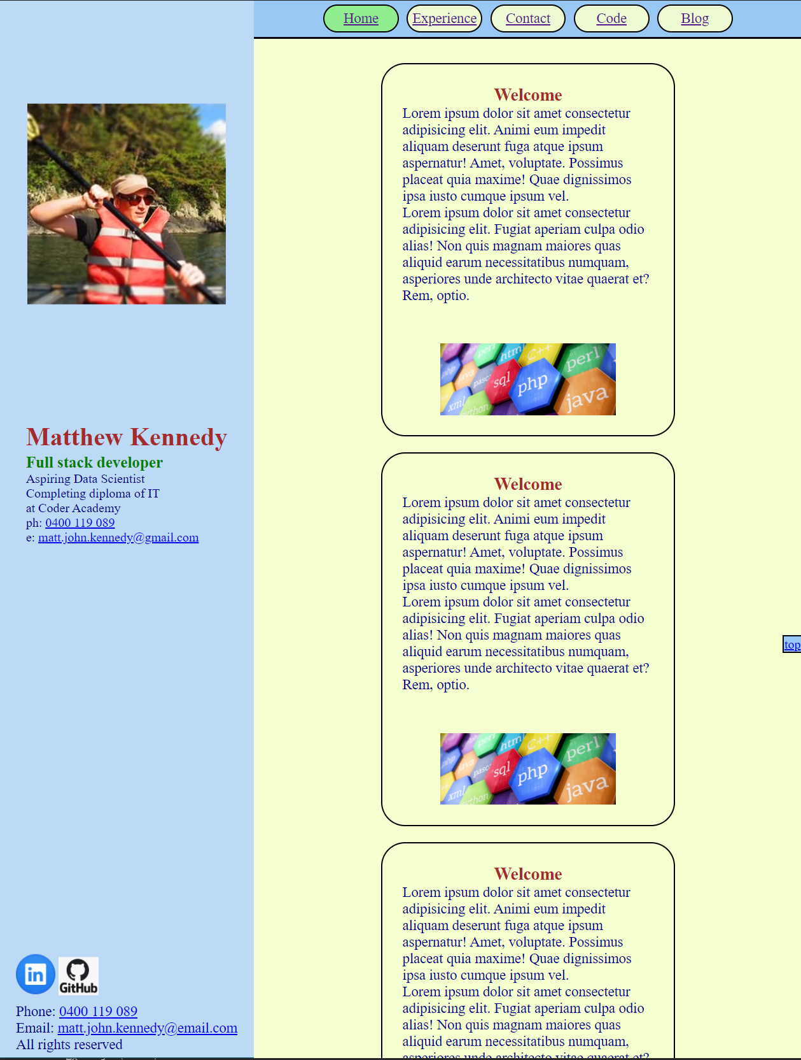
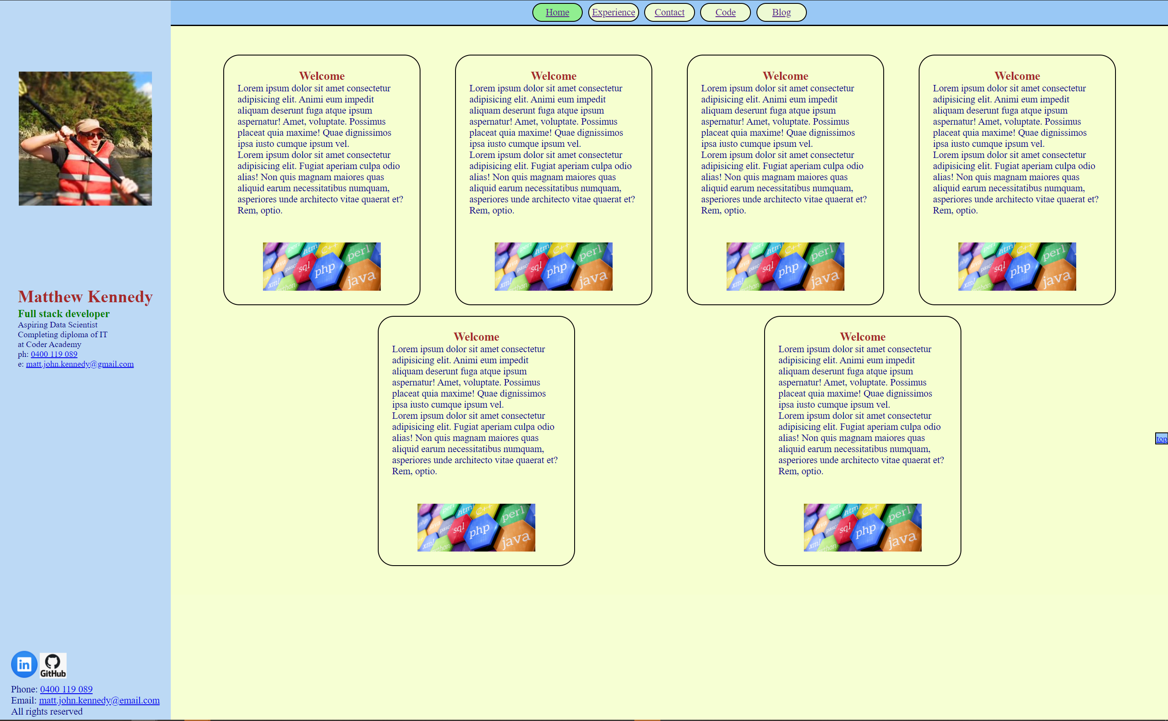
Design – Components Used - How it engages audience
mob-social-media
social-media
nav
headerinfo
body-content
Profpic
Block
To-top

Slide 12

Action
Get the paperwork ready
Find out when we can start working together
Book it all in!

Slide 13
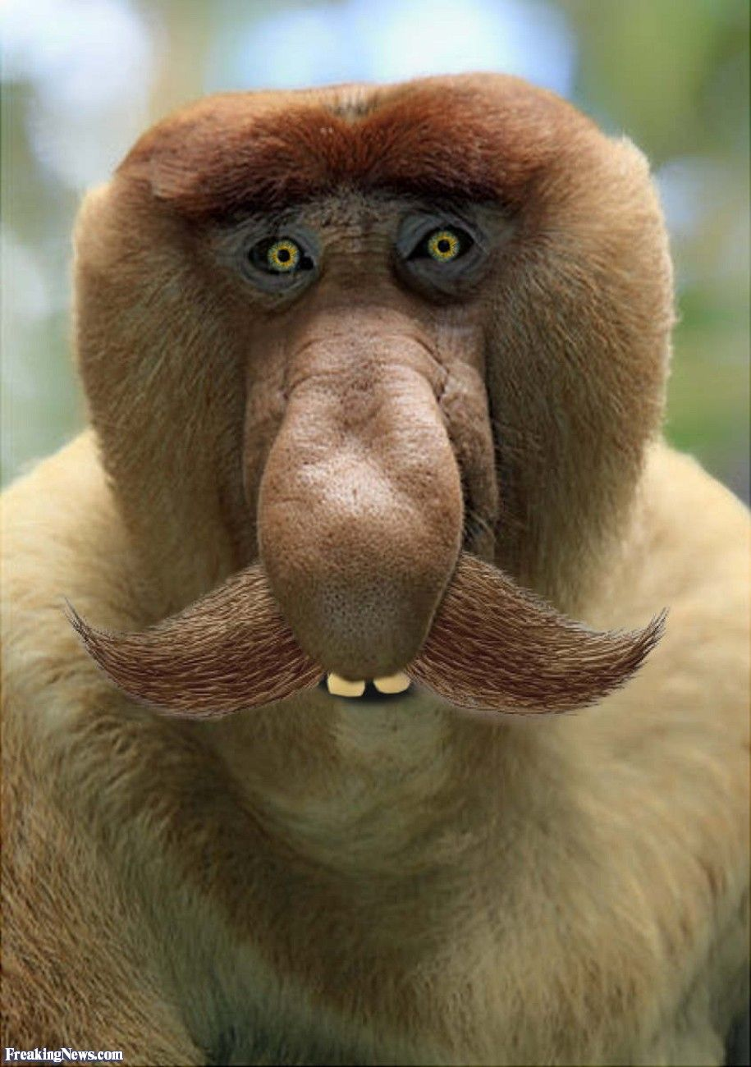
Benefit
Increased productivity
Access code easily with cleaner code
Meet your new coder

Slide 14

Thank You!

